Slide 1
Course Name : Data Structures & Algorithms
Bharat Deshpande
Computer Science & Information Systems

Slide 2
Linear data structures
Here are some of the data structures we have studied so far:
Arrays
Singly-linked lists and doubly-linked lists
Stacks and queues
These all have the property that their elements can be adequately displayed in a straight line
How to obtain data structures for data that have nonlinear relationships

Slide 3
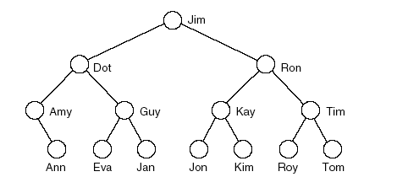
Tree
Tree represents hierarchy.
Examples of trees:
- Directory tree
- Family tree
- Company organization chart
Table of contents
structure resembles branches of a “tree”, hence the name.

Slide 4
Trees
Trees have nodes. They also have edges that
connect the nodes.
Between two nodes there is always only one path.
Tree nodes
Tree edges

Slide 5
Trees: More Definitions
Trees that we consider are rooted. Once the root is defined (by the user) all nodes have a specific level.
Trees have internal nodes and leaves. Every node (except the root) has a parent and it also has zero or more children.
root
level 0
level 1
internal nodes
level 2
parent
and
child
level 3
leaves

Slide 6
Tree Terminology (1)
A vertex (or node) is a object that can have a name and can carry other associated information
• The first or top node in a tree is called the root node.
• An edge is a connection between two vertices
• A path in a tree is a list of distinct vertices in which successive vertices are connected by edges in the tree.
• The defining property of a tree is that there is precisely one path connecting any two nodes.
• A disjoint set of trees is called a forest
• Nodes with no children are leaves, terminal or external nodes

Slide 7
Tree Terminology (2)
Child of a node u :- Any node reachable from u by 1 edge.
Parent node :- If b is a child of a, then a is the parent of b.
- All nodes except root have exactly one parent.
Subtree:-any node of a tree, with all of its descendants.
Depth of a node :
- Depth of root node is 0.
-Depth of any other node is 1 greater than depth of its parent.

Slide 8
Tree Terminology (3)
The size of a tree is the number of nodes in it
Height : Maximum of all depths.
Each node except the root has exactly one node above it in the tree, (i.e. it’s parent), and we extend the family analogy talking of children, siblings, or grandparents
Nodes that share parents are called siblings.

Slide 9
Binary Trees
Definition: A binary tree is either empty or it consists
of a root together with two binary trees called the
left subtree and the right subtree.
A binary tree is a tree in which each node has atmost
2 children

Slide 10
Properties of Binary trees
Proper Binary Tree
- Each internal node has exactly two children
Let
n - number of nodes
n_{e} – number of external nodes or leaves
n_{i} – number of internal nodes
h – height of T, Then the following holds:
h+1 <= n_{e} <= 2^{h}
h <= n_{i} <= 2^{h} – 1
h + 1 <= n <= 2^{h+1} -1
log(n+1) – 1 <= h <= (n -1)/2

Slide 11
Complete Binary Trees
Nodes in trees can contain keys (letters, numbers, etc)
Complete binary tree: A binary tree in which every level, except possibly the deepest, is completely filled. At depth n, the height of the tree, all nodes must be as far left as possible.
14
10
16
8
12
15
18
7
9
11
13

Slide 12
Complete Binary Trees: Array Representation
Complete Binary Trees can be represented in
memory with the use of an array A so that all
nodes can be accessed in O(1) time:
Label nodes sequentially top-to-bottom and left-to-right
Left child of A[i] is at position A[2i]
Right child of A[i] is at position A[2i + 1]
Parent of A[i] is at A[i/2]

Slide 13
Complete Binary Trees: Array Representation
1
14
2
3
10
16
4
5
6
7
8
12
15
18
8
9
10
11
7
9
11
13

Slide 14
Binary Trees: Linked List Representation
A Binary tree is a linked data structure. Each node contains data (including a key and satellite data), and pointers left, right and p.
Left points to the left child of the node.
Right points to the right child of the node.
p points to the parent of the node.
If a child is missing, the pointer is NIL.
If a parent is missing, p is NIL.
The root of the tree is the only node for which p is NIL.
Nodes for which both left and right are NIL are leaves.

Slide 15
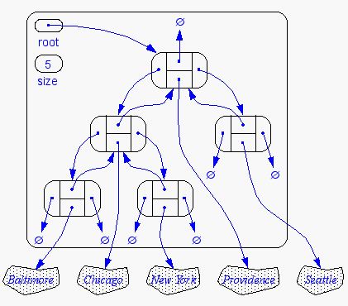
Binary Trees: Linked List Representation

Slide 16
Binary Tree Traversals
A binary tree is defined recursively: it consists of a root, a left subtree and a right subtree
To traverse (or walk) the binary tree is to visit each node in the binary tree exactly once.
Tree traversals are naturally recursive.
Since a binary tree has three parts, there are six possible ways to traverse the binary tree:
root, left, right : preorder (root, right, left)
left, root, right: inorder (right, root, left)
left, right, root: postorder (right, left, root)

Slide 17
Binary Tree Traversals
1
preorder: 1 2 3
inorder: 2 1 3
postorder: 2 3 1
2
3

Slide 18
Tree Traversal: InOrder
In-order traversal
Visit left subtree (if there is one) In Order
print the key of the current node
Visit right subtree (if there is one) In Order
I

Slide 19
Tree Traversal: PreOrder
Another common traversal is PreOrder.
It goes as deep as possible (visiting as it goes) then left to right
print root
Visit left subtree in PreOrder
Visit right subtree in PreOrder

Slide 20
Tree Traversal: PostOrder
PostOrder traversal also goes as deep as possible, but only visits internal nodes during backtracking.
recursive:
Visit left subtree in PostOrder
Visit right subtree in PostOrder
print root

Slide 21
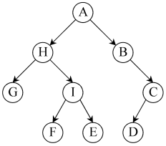
Tree Traversal: examples
Preorder (DLR) traversal yields: A, H, G, I, F, E, B, C, D
Postorder (LRD) traversal yields: G, F, E, I, H, D, C, B,
In-order (LDR) traversal yields: G, H, F, I, E, A, B, D, C

Slide 22
Tree Traversal: examples
* Preorder (DLR) traversal yields: A, H, G, I, F, E, B, C, D
* Postorder (LRD) traversal yields: G, F, E, I, H, D, C, B, A
* In-order (LDR) traversal yields: G, H, F, I, E, A, B, D, C

